Slide 1
Respiratory Failure
5 курс

Slide 36
Classification of RF
  Type 1
Hypoxemic RF **
PaO2 < 60 mmHg with normal or ↓ PaCO2
Associated with acute diseases of the lung
Pulmonary edema (Cardiogenic, noncardiogenic (ARDS), pneumonia, pulmonary hemorrhage, and collapse
  Type 2
Hypercapnic RF
PaCO2 > 50 mmHg
Hypoxemia is common
Drug overdose, neuromuscular disease, chest wall deformity, COPD, and Bronchial asthma

Slide 37
Distinction between Acute and Chronic RF
Acute RF
Develops over minutes to hours
↓ pH quickly to <7.2
Example; Pneumonia
Chronic RF
Develops over days
↑ in HCO3
↓ pH slightly
Polycythemia, Corpulmonale
Example; COPD

Slide 38
More definitions
Hypoxemia = abnormally low PaO2
Hypoxia = tissue oxygenation inadequate to meet metabolic needs
Hypercarbia = elevated PaCO2
Respiratory failure may be acute or chronic

Slide 39
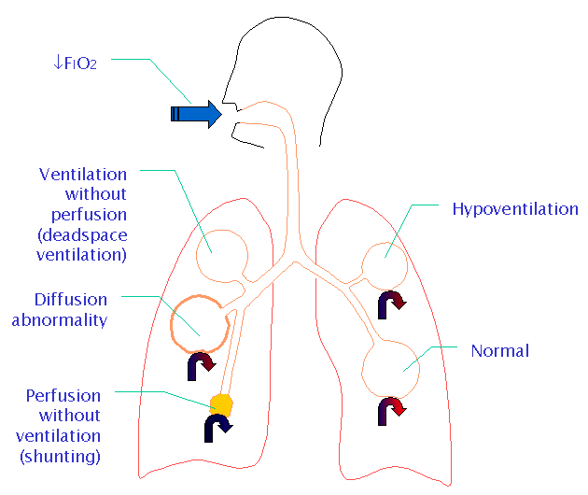
Pathophysiologic causes of Acute RF
●Hypoventilation
●V/P mismatch
●Shunt
●Diffusion abnormality

Slide 40

CO2
O2
Notes:
The major function of the lung is to get oxygen into the body and carbon dioxide out

Slide 41
Mechanisms of hypoxemia
Alveolar hypoventilation
V/Q mismatch
Shunt
Diffusion limitation
Other issues we will not consider
  Low FIO2
  Low barometric pressure

Slide 42
↓FIO2
Ventilation without perfusion
(deadspace ventilation)
Hypoventilation
Diffusion abnormality
Normal
Perfusion without ventilation (shunting)
Notes:
Shunting is the most common cause for hypoxaemic respiratory failure in ICU patients.
It is a form of ventilation-perfusion mismatch in which alveoli which are not ventilated (eg due to collapse or pus or oedema fluid) are still perfused.

Slide 43
Perfusion without ventilation (shunting)
Intra-pulmonary
Small airways occluded ( e.g asthma, chronic bronchitis)
Alveoli are filled with fluid ( e.g pulm edema, pneumonia)
Alveolar collapse ( e.g atelectasis)

Slide 44
Dead space ventilation
DSV increase:
Alveolar-capillary interface destroyed e.g emphysema
Blood flow is reduced e.g CHF, PE
Overdistended alveoli e.g positive- pressure ventilation

Slide 45
↓FIO2
Ventilation without perfusion
(deadspace ventilation)
Hypoventilation
Diffusion abnormality
Normal
Perfusion without ventilation (shunting)
Notes:
Hypoventilation

Slide 46
Hypercarbia
Hypercarbia is always a reflection of inadequate ventilation
PaCO2 is
  directly related to CO2 production
  Inversely related to alveolar ventilation
PaCO2 = k x VCO2
VA

Slide 47
Hypercarbia
When CO2 production increases, ventilation increases rapidly to maintain normal PaCO2
Alveolar ventilation is only a fraction of total ventilation
  VA = VE – VD
Increased deadspace or low V/Q areas may adversely effect CO2 removal
Normal response is to increase total ventilation to maintain appropriate alveolar ventilation

Slide 48
Common causes
Hypercapnic RF typ II
Hypoxemic RF typI
Pneumonia,
pulmonary edema
Pulmonary embolism,
ARDS
Cyanotic congenital heart disease
Chronic bronchitis,emphysema
Severe asthma, drug overdose
Poisonings, Myasthenia gravis
Polyneuropathy, Poliomyelitis
Primary ms disorders
1ry alveolar hypoventilation
Obesity hypoventilation synd.
Pulmonary edema, ARDS
Myxedema, head and cervical cord injury

Slide 49
Brainstem
Spinal cord
Airway
Nerve root
Lung
Nerve
Pleura
Neuromuscular junction
Chest wall
Respiratory muscle
Sites at which disease may cause ventilatory disturbance
Notes:
Hypoventilation can be caused by disease at any of the anatomical sites involved in ventilation. Brainstem injury or disease may result in impaired functioning of the respiratory centre, which may also be suppressed by depressant drugs

Slide 50
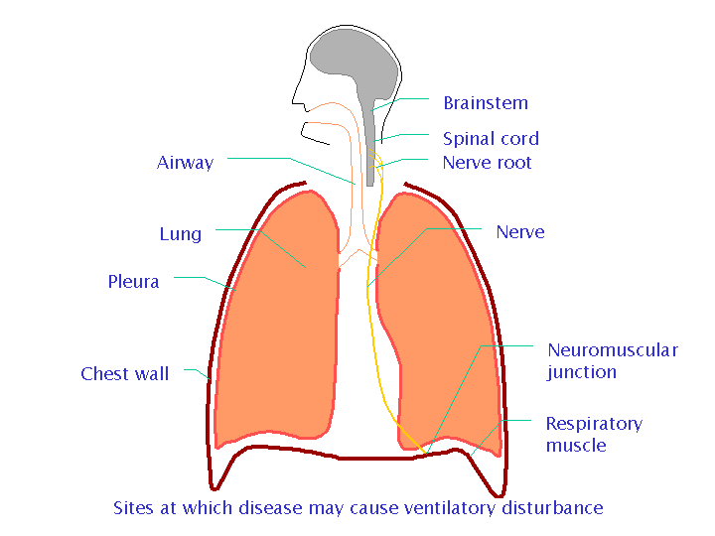
Causes
1 – CNS
Depression of the neural
  drive to breath
Brain stem tumors or vascular abnormality
Overdose of a narcotic, sedative
  Myxedema, chronic metabolic
  alkalosis
Acute or chronic hypoventilation
  and hypercapnia

Slide 51
Causes
2 - Disorders of peripheral
nervous system, Respiratory ms, and Chest wall
Inability to maintain a level of minute ventilation appropriate for the rate of CO2 production
Guillian-Barre syndrome, muscular dystrophy, myasthenia gravis, KS, morbid obesity
Hypoxemia and hypercapnia

Slide 52
Causes
3 - Abnormities of the airways
Upper airways
  Acute epiglotitis
  Tracheal tumors
Lower airway
  COPD, Asthma, cystic fibrosis
Acute and chronic hypercapnia

Slide 53
Causes
4 - Abnormities of the alveoli
Diffuse alveolar filling
hypoxemic RF
  Cardiogenic and noncardiogenic pulmonary edema
  Aspiration pneumonia
  Pulmonary hemorrhage
Associate with Intrapulmonary shunt and increase work of breathing

Slide 54
Diagnosis of RF
1 – Clinical (symptoms, signs)
Hypoxemia
Dyspnea, Cyanosis
Confusion, somnolence, fits
Tachycardia, arrhythmia
Tachypnea (good sign)
Use of accessory ms
Nasal flaring
Recession of intercostal ms
Polycythemia
Pulmonary HTN, Corpulmonale, Rt. HF
Hypercapnia
↑Cerebral blood flow, and CSF Pressure
Headache
Asterixis
Papilloedema
Warm extremities, collapsing pulse
Acidosis (respiratory, and metabolic)
↓pH, ↑ lactic acid

Slide 55
Respiratory Failure
Symptoms
CNS:
Headache
Visual Disturbances
Anxiety
Confusion
Memory Loss
Weakness
Decreased Functional Performance

Slide 56
Respiratory Failure
Symptoms
Pulmonary:
Cough
Chest pains
Sputum production
Stridor
Dyspnea

Slide 57
Respiratory Failure
Symptoms
Cardiac:
Orthopnea
Peripheral edema
Chest pain
Other:
Fever, Abdominal pain, Anemia, Bleeding

Slide 58
Clinical
Respiratory compensation
Sympathetic stimulation
Tissue hypoxia
Haemoglobin desaturation
Notes:
Clinical signs of respiratory failure can be divided into signs of respiratory compensation

Slide 59
Clinical
Respiratory compensation
  Tachypnoea RR > 35 Breath /min
  Accessory muscles
  Recesssion
  Nasal flaring
Sympathetic stimulation
Tissue hypoxia
Haemoglobin desaturation
Notes:
Such as tachypnoea, use of accessory muscles, recession and nasal flaring

Slide 60
Clinical
Respiratory compensation
Sympathetic stimulation
  ↑HR
  ↑BP
  Sweating
  Tissue hypoxia
  Altered mental state
  ↓HR and ↓BP (late)
  Haemoglobin desaturation cyanosis
Notes:
Signs of sympathetic stimulation such as tachycardia, hypertension and sweating

Slide 61
Clinical
Altered mental state
⇓PaO2 +⇑PaCO2 ⇨ acidosis ⇨ dilatation of cerebral resistance vesseles ⇨ ⇑ICP
Disorientation Headache
coma asterixis
personality changes

Slide 62
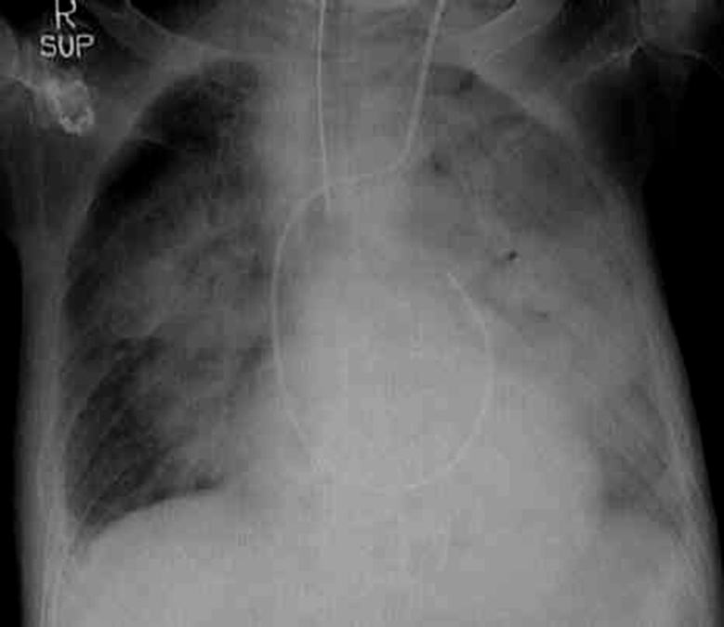
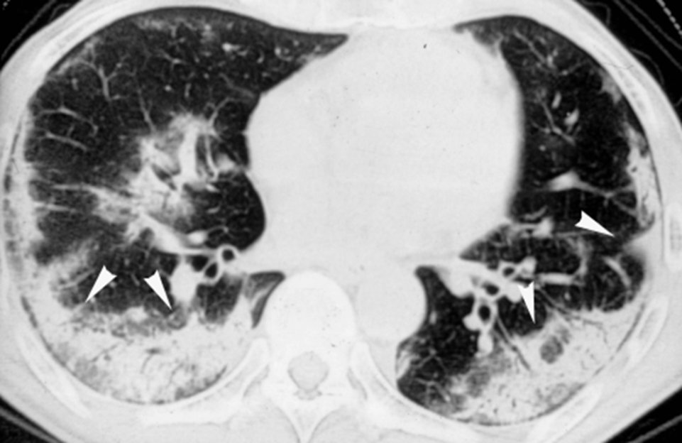
Respiratory Failure
Laboratory Testing
Arterial blood gas
PaO2
PaCO2
PH
Chest imaging
Chest x-ray
CT sacn
Ultrasound
Ventilation–perfusion scan

Slide 63
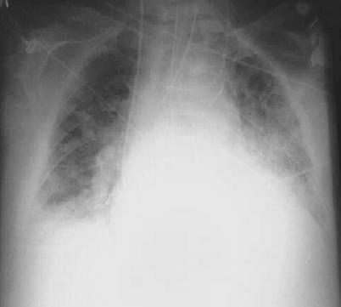
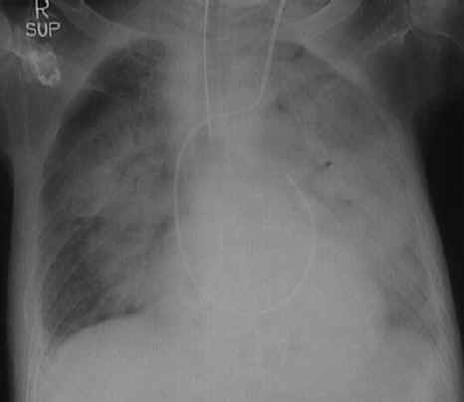
Distinction between Noncardiogenic (ARDS) and Cardiogenic pulmonary edema
Pulmonary edema
ARDS

Slide 64
Pulse oximetry
90
Sources of error
Poor peripheral perfusion
Excessive motion
Carboxyhaemoglobin or methaemoglobin
Hb saturation (%)
8
PaO2 (kPa)
Notes:
The pulse oximeter is an extremely useful monitor which estimates arterial saturation
the relationship between saturation and PaO₂ is described by the oxyhaemoglobin dissociation curve
a saturation ~90% is a critical threshold because below this level a small fall in PaO₂ produces a sharp fall in SpO₂ .Conversely a rise in arterial PO2 has little effect on saturation and therefore little effect on oxygen delivery to tissues

Slide 65
Case 1
A 36 yo man who has had a recent viral illness now is admitted to the ICU with rapidly progressive ascending paralysis (diagnosed as Guillain-Barre Syndrome). He is breathing shallowly at 36/min and complains of shortness of breath. His lungs are clear on exam. CXR shows small lung volumes without infiltrates. With the patient breathing room air, ABG are obtained.
pH= 7.18
PaCO2= 68 mm Hg
PaO2 =49 mm Hg
HCO3=14mmol/l
His hypoxemia is due to alveolar hypoventilation
ACUTE RESP FALURE

Slide 66
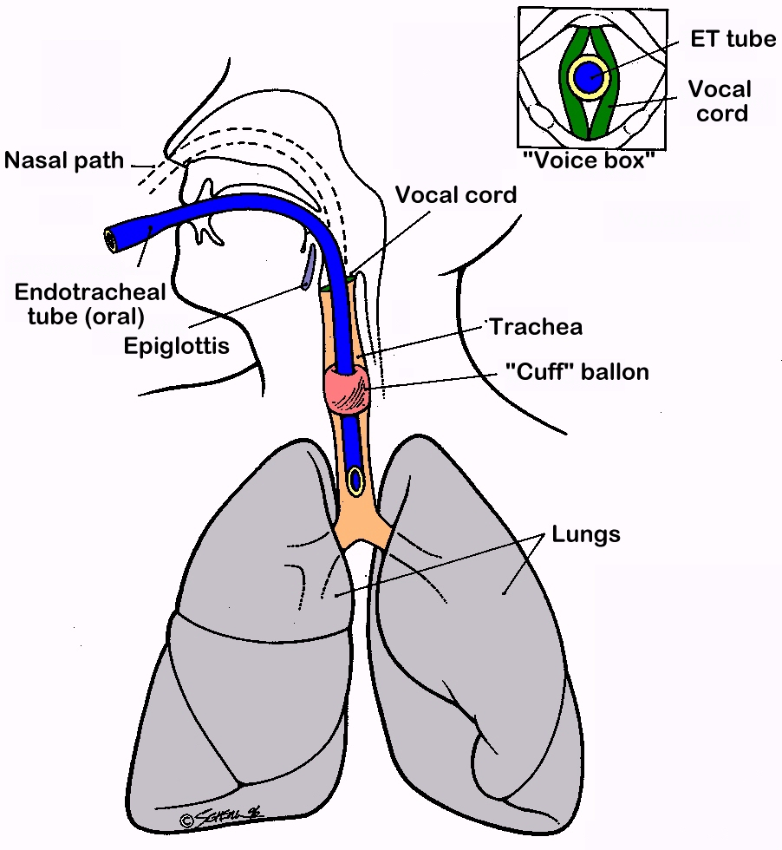
Endotracheal intubation and positive pressure ventilation

Slide 67
Indications for intubation and mechanical ventilation
inability to protect the airway
respiratory acidosis (pH<7.2)
refractory hypoxemia
fatigue/increased metabolic demands
  impending respiratory arrest
pulmonary toilet

Slide 68
Case 2
A 65 yo man has smoked cigarettes for 50 yrs. He has chronic cough with sputum production and chronic dyspnea on exertion (stops once when climbing 1 flight of stairs). He is now admitted with several days of increased cough productive of green sputum and is short of breath even at rest. On exam his breathing is labored (32/min) and his breath sounds are quite distant. The expiratory phase is greatly prolonged and there are soft wheezes in expiration.
  pH=7.38
  PCO2=48
  PO2=48
  O2 sat=78%
  HC03=38mmol/l
His hypoxemia is predominantly due to V/Q mismatch
chronic respiratory acidosis

Slide 69
Case 2- treatment
Supplemental oxygen
  Nasal canula
  Humidified mask
  Venturi mask
  Reservoir mask
  Endotracheal tube
The goal of therapy is to achieve adequate oxygen content for O2 delivery.

Slide 70
Case 2 - treatment
  The patient received 100% oxygen by reservoir mask and a small dose of medication to help him relax.
  One hour later he is hard to arouse and his ABG shows
  pH 7.25, PaCO2 64, PaO2 310
    Has he improved?
    What is his acid-base status now?
    What happened?

Slide 71
Oxygen therapy
Like most other therapies, Oxygen therapy has both benefits and risks
Potential complications of oxygen therapy
  Acute lung injury
  Retrolental fibroplasia
  Decreased respiratory drive in individuals with chronic hypercarbia
Use the lowest possible FIO2 to achieve adequate O2 saturation for oxygen delivery

Slide 72
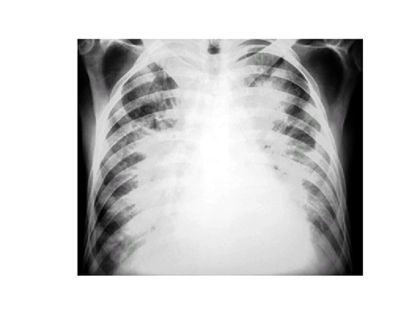
Case 3
A 56 yo man with known coronary artery disease and a prior myocardial infarction has had 1 hr of substernal chest pressure associated with nausea and diaphoresis. When you first see him, he is sitting upright in obvious distress and is cyanotic. He is breathing 36/min with short, shallow breaths. On examination of the chest he has dense inspiratory rales (crackles) half way up his back on both sides. Cardiac exam reveals faint heart sounds with an S3 gallop.

Slide 73
Case-3 ABG’s
 | room air | FIO2 = 1.0
pH | 7.28 | 7.27
PCO2 | 32 | 33
PO2 | 43 | 76
O2 sat A-aO2 gradient | 72% 66 mmHg | 95%
Mechanism of hypoxemia ⇒ shunt
CARDIOGEN PULMONARY EDEM

Slide 74
Respiratory physiology of congestive heart failure
Vascular congestion – increased capillary blood volume, mild bronchoconstriction, mild decrease in lung compliance; PaO2 normal or even increased
Interstitial edema – decreased compliance and lung volumes, worsening dyspnea, V/Q abnormality and widened A-a O2 gradient
Alveolar flooding – lung units that are perfused but not ventilated, shunt physiology with profound gas exchange abnormalities, decreased compliance and lung volumes

Slide 75
Treatment of cardiogenic pulmonary edema
Correct the problem with left ventricular function
  Diruetics
  Nitrates
  Vasodilators
  Thrombolytics, etc.
Decrease work of breathing
  Ventilatory support
Improve oxygenation
  Supplemental oxygen
  Mechanical ventilation

Slide 76
Distinction between Noncardiogenic (ARDS) and Cardiogenic pulmonary edema
ARDS
Tachypnea, dyspnea, crackles
Aspiration, sepsis
3 to 4 quadrant of alveolar flooding with normal heart size, systolic, diastolic function
Decreased compliance
Severe hypoxemia refractory to O2 therapy
PCWP is normal <18 mm Hg
Cardiogenic edema
Tachypnea, dyspnea, crackles
Lt ventricular dysfunction, valvular disease, IHD
Cardiomegaly, vascular redistribution, pleural effusion, perihilar bat-wing distribution of infiltrate
Hypoxemia improved on high flow O2
PCWP is High >18 mmHg

Slide 77
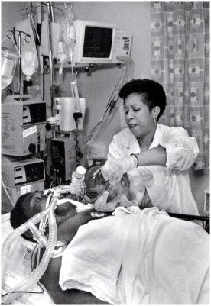
Management of ARF
ICU admition
1 -Airway management
  Endotracheal intubation:
    Indications
      Severe Hypoxemia
      Altered mental status
  Importance
    precise O2 delivery to the lungs
    remove secretion
    ensures adequate ventilation

Slide 78
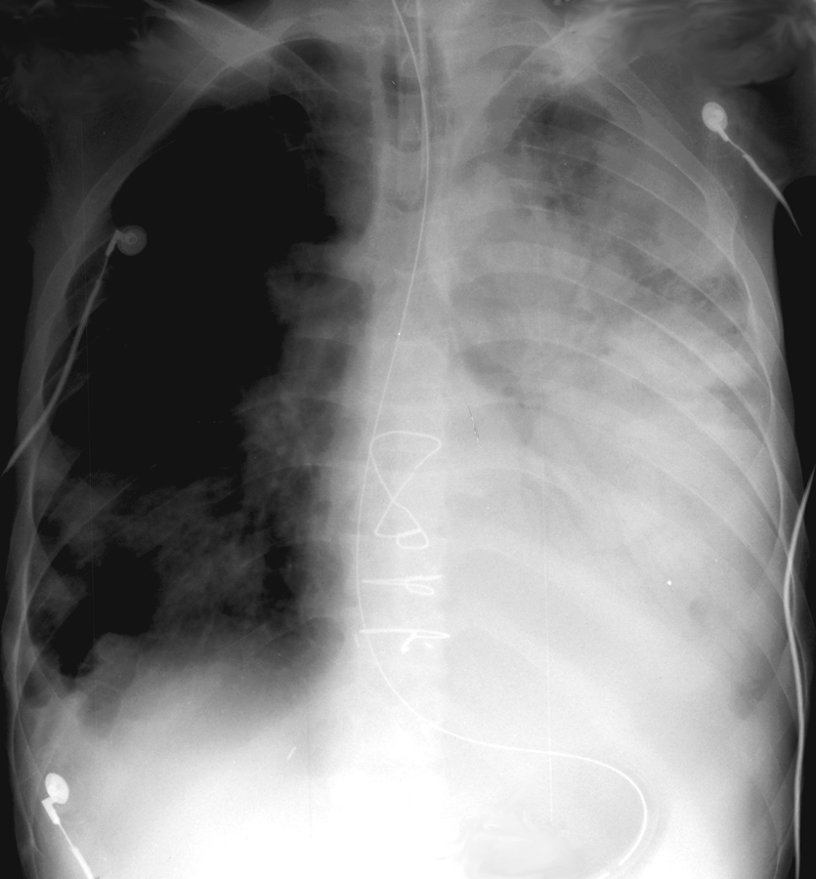
Management of ARF
2 -Correction of hypoxemia
  O2 administration via nasal prongs, face mask, intubation and Mechanical ventilation
  Goal: Adequate O2 delivery to tissues
  PaO2 = > 60 mmHg
  Arterial O2 saturation >90%

Slide 79
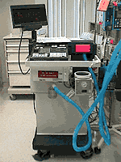
Management of ARF
4 – Mechanical ventilation
Indications
  Persistence hypoxemia despite O2supply
  Decreased level of consciousness
  Hypercapnia with severe acidosis (pH< 7.2)

Slide 80
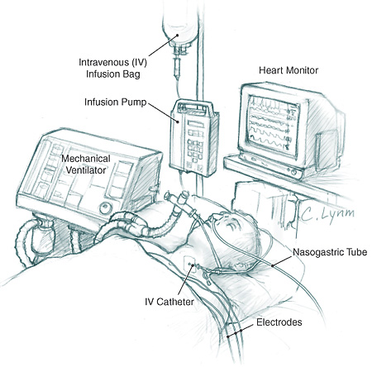
Management of ARF
4 - Mechanical ventilation
  Increase PaO2
  Lower PaCO2
  Rest respiratory ms (respiratory ms fatigue)
  Ventilator
    Assists or controls the patient breathing
  The lowest FIO2 that produces SaO2 >90% and PO2 >60 mmHg should be given to avoid O2 toxicity

Slide 81
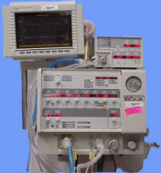
Management of ARF
5 -PEEP (positive End-Expiratory pressure
Used with mechanical ventilation
  Increase intrathoracic pressure
  Keeps the alveoli open
  Decrease shunting
  Improve gas exchange
Hypoxemic RF (type 1)
  ARDS
  Pneumonias

Slide 82
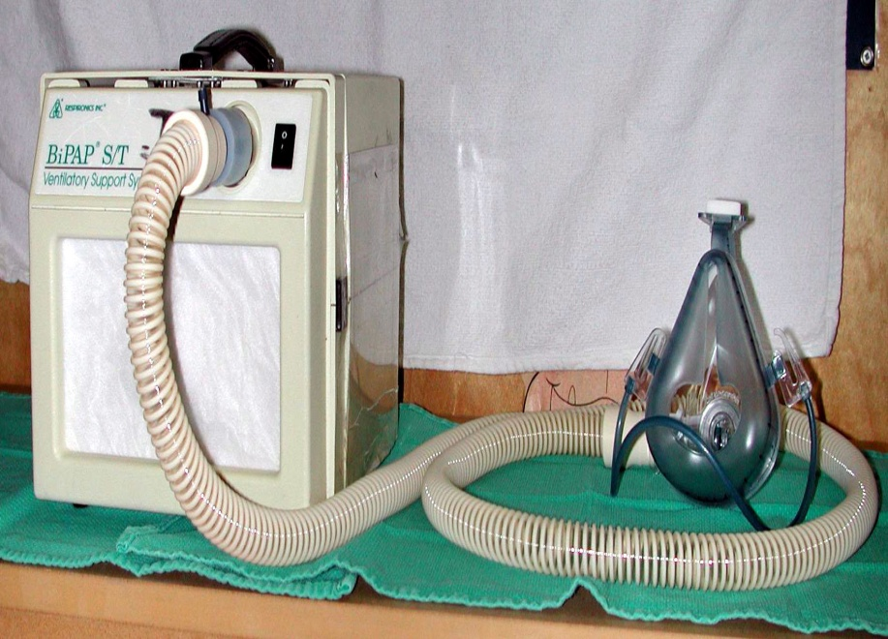
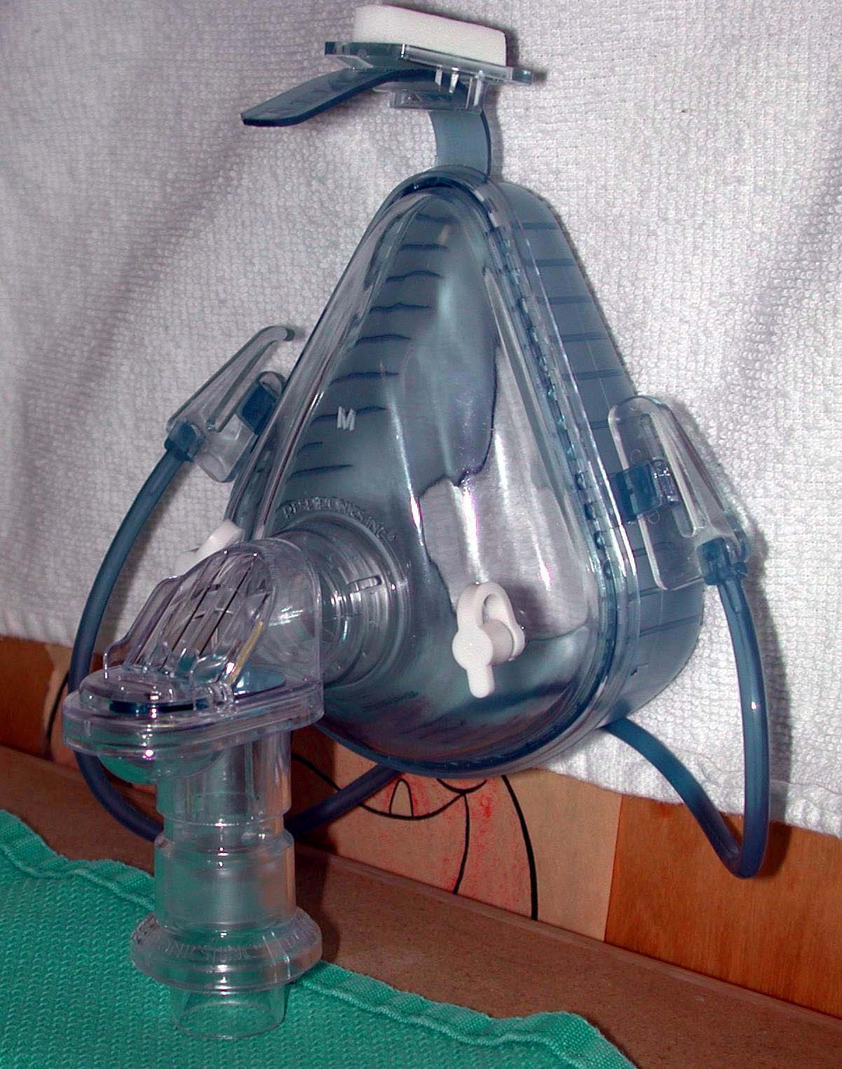
Management of ARF
6 - Noninvasive Ventilatory support (IPPV)
Mild to moderate RF
Patient should have
  Intact airway,
  Alert, normal airway protective reflexes
Nasal or full face mask
  Improve oxygenation,
  Reduce work of breathing
  Increase cardiac output
AECOPD, asthma, CHF

Slide 83
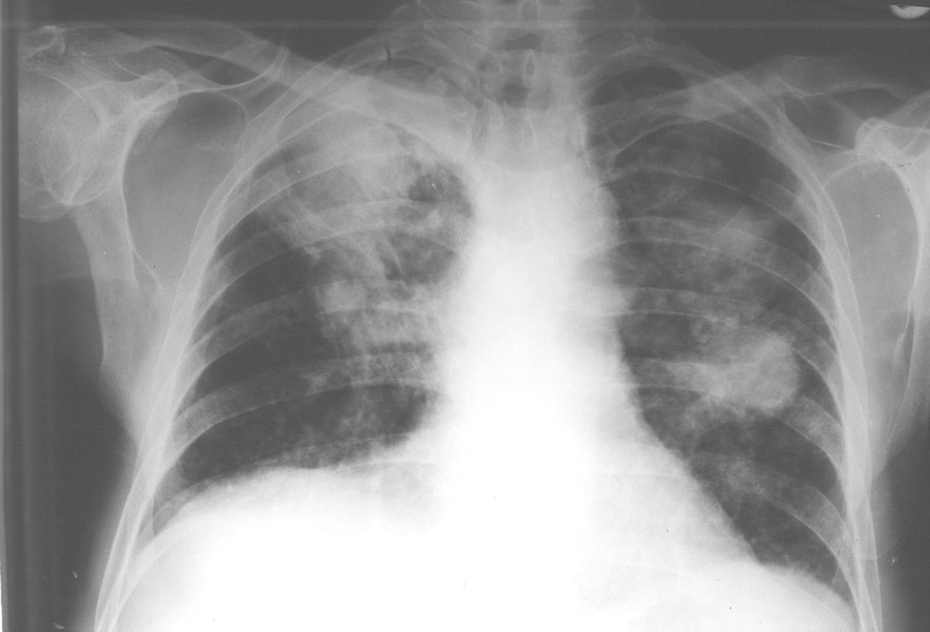
Management of ARF
7 - Treatment of the underlying causes
After correction of hypoxemia, hemodynamic stability
Antibiotics
  Pneumonia
  Infection
Bronchodilators (COPD, BA)
  Salbutamol
    reduce bronchospasm
    airway resistance
Notes:
83

Slide 84
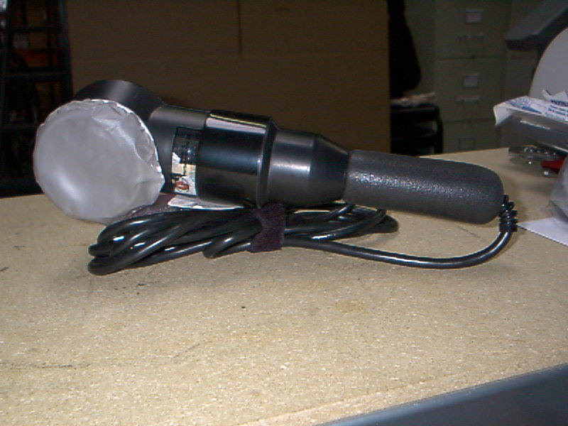
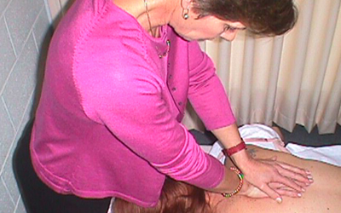
Management of ARF
7 - Treatment of the underlying causes
Physiotherapy
  Chest percussion to loosen secretion
  Suction of airways
  Help to drain secretion
  Maintain alveolar inflation
  Prevent atelectasis, help lung expansion

Slide 85
Management of ARF
8 - Weaning from mechanical ventilation
  Stable underlying respiratory status
  Adequate oxygenation
  Intact respiratory drive
  Stable cardiovascular status
  Patient is a wake, has good nutrition, able to cough and breath deeply

Slide 86
Complications of ARF
Pulmonary
  Pulmonary embolism
  barotrauma
  pulmonary fibrosis (ARDS)
  Nosocomial pneumonia
Cardiovascular
  Hypotension, ↓COP
  Arrhythmia
  MI, pericarditis
GIT
  Stress ulcer, ileus, diarrhea, hemorrhage
Infections
  Nosocomial infection
  Pneumonia, UTI, catheter related sepsis
Renal
  ARF (hypoperfusion, nephrotoxic drugs)
  Poor prognosis
Nutritional
  Malnutrition, diarrhea hypoglycemia, electrolyte disturbances

Slide 87
Prognosis of ARF
Mortality rate for ARDS → 40%
  Younger patient <60 has better survival rate
  75% of patient survive ARDS have impairment of pulmonary function one or more years after recovery
Mortality rate for COPD →10%
  Mortality rate increase in the presence of hepatic, cardiovascular, renal, and neurological disease

